Slide 1
IPOL
Aspen Lee

Slide 2
California Department of Transportation
Mission Statement: “Provide a safe, sustainable, integrated and efficient transportation system to enhance California’s economy and livability”
Manages state highway system and involved with public transportation
District 11 – San Diego & Imperial Counties
Engineering: Advanced Planning

Slide 3
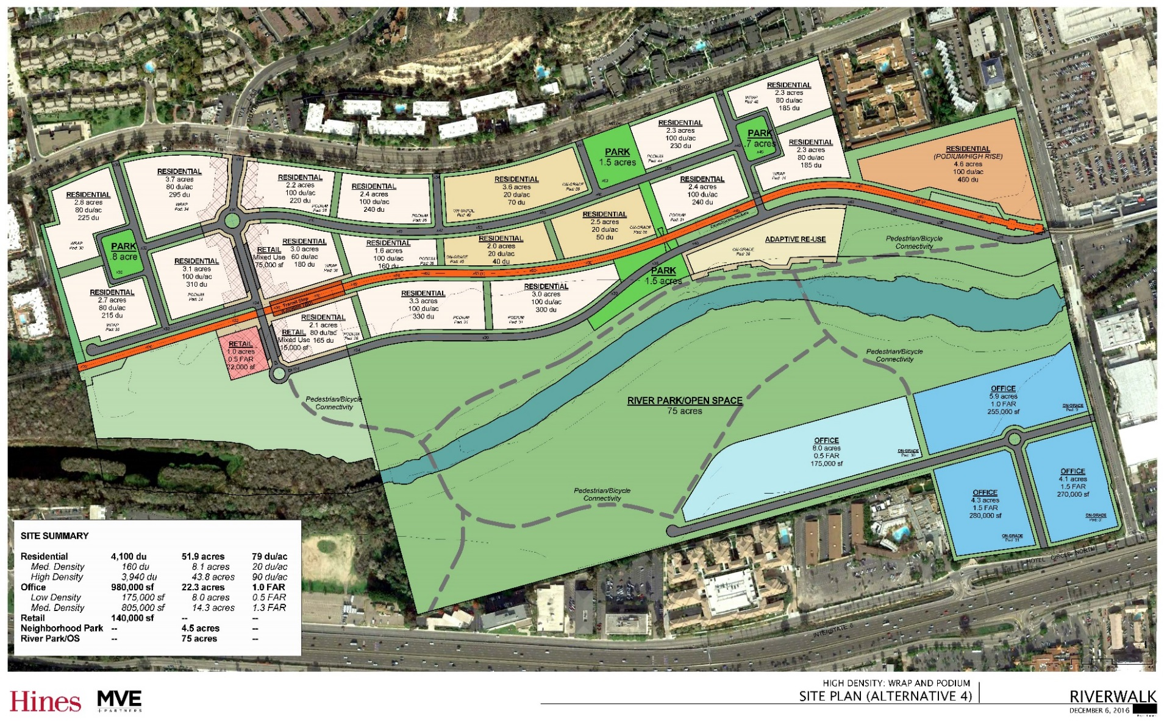
Background
Site Plan
Overview of project site:

Slide 4
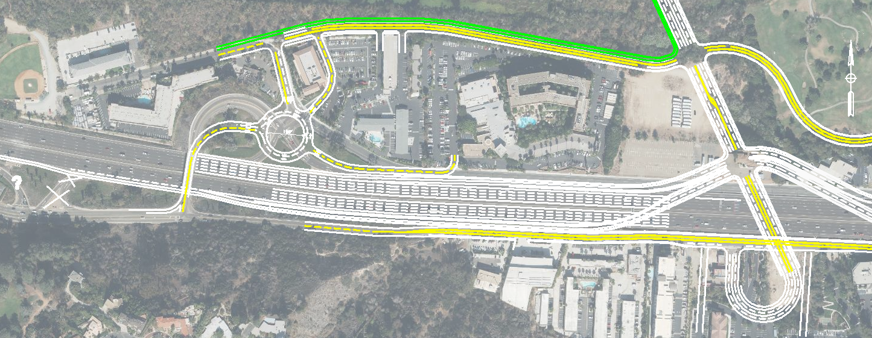
Via Las Cumbres Project Proposal
Overview:
Reason: City of San Diego wants to explore the possibility of additional access points for the proposed development
One of the alternatives

Slide 5
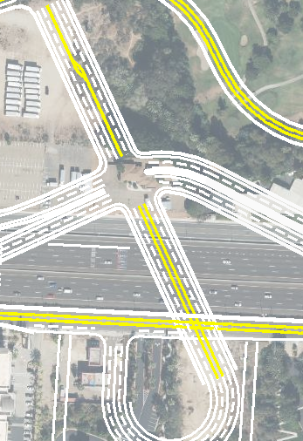
Main Intersection
Via Las Cumbres and On and Off Ramps for I-8
Presidio Off and On ramps going East and West bound and Hotel Circle’s West bound On ramp would be affected
Elevated Ramps
Skewed Single Point Intersection
New intersection
Intersection and Traffic Analysis
Via Las Cumbres
I-8

Slide 6
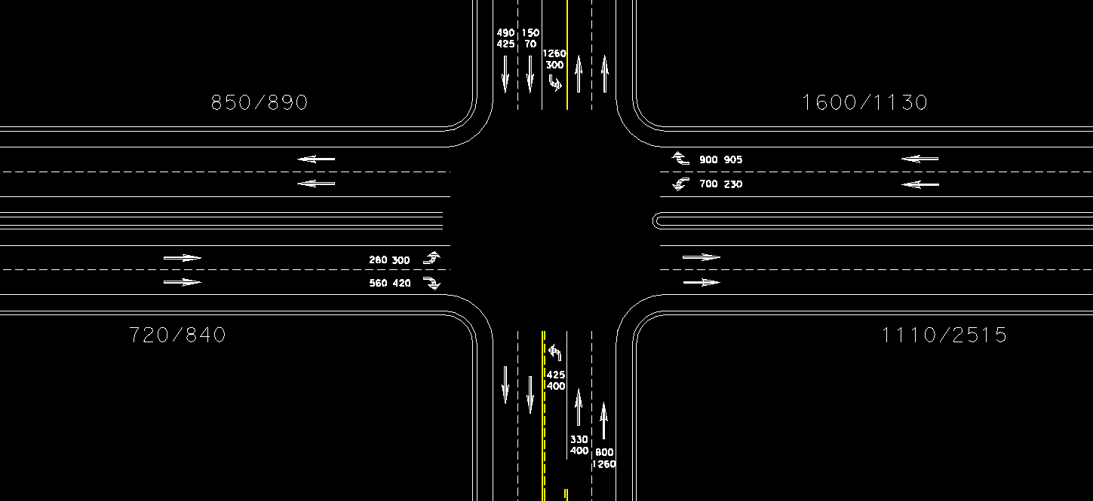
Main Intersection
Traffic Analysis
Lane Distribution
Using the existing peak hour volumes in an hour during the day expected to go through the intersection, I was tasked to figure out how the cars would be distributed between the lanes from the proposal

Slide 7
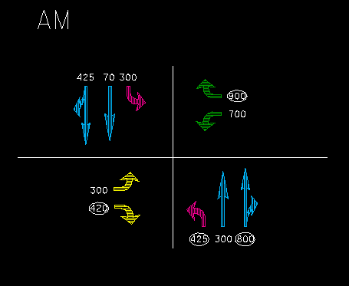
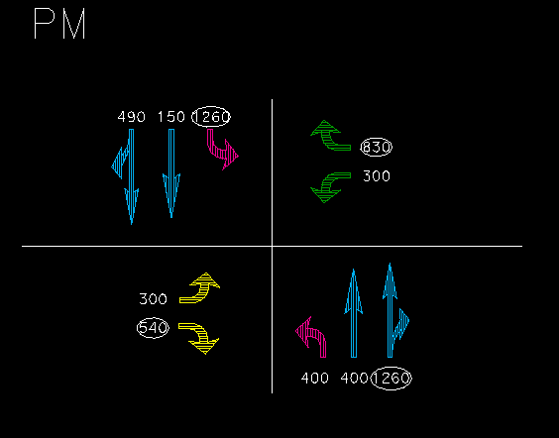
Phases
Intersecting Lane Vehicles (ILV) Method
Planning Level Analysis
Reason: To determine the flow of the intersection
A traffic phase is one part of a cycle where a traffic light is green and only those specific lanes are directed to go
The numbers circled and added up are the highest numbers in each phase a.k.a. Critical Lane Volumes
ILV/hr Ranges
<1200: Stable
1200-1500: Unstable flow with possible delays
>1500 (Capacity): Severe delay and heavy congestion
2545 ILV/Hr.
3890 ILV/Hr.

Slide 8
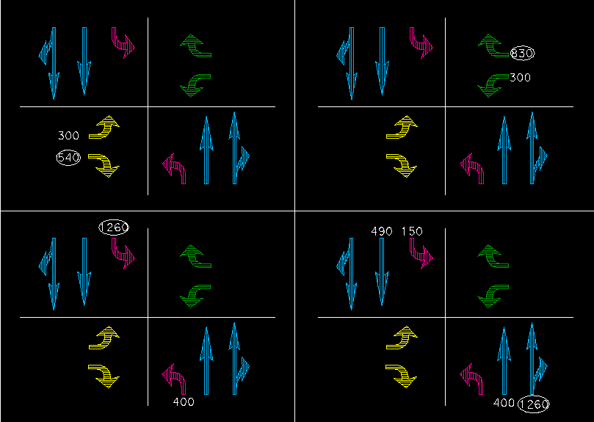
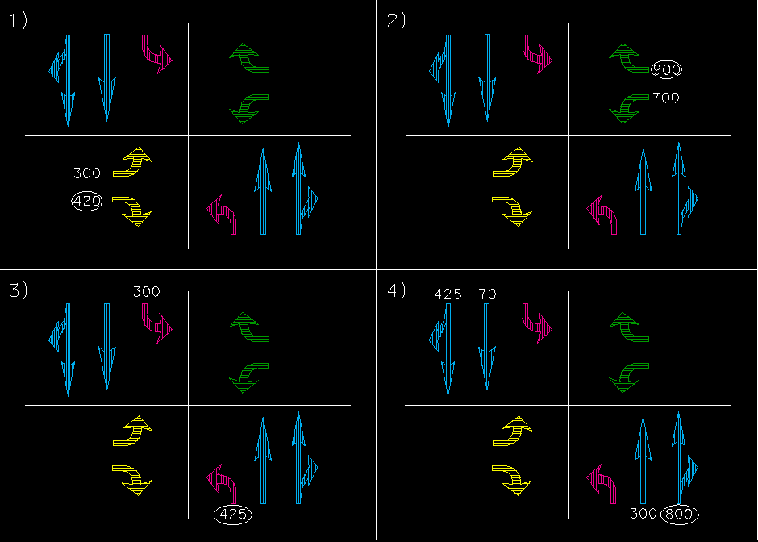
AM
PM
Critical Lane Volumes:
ILV=Intersecting Lane Vehicles
420
900
425
800
540
1260
830
1260
______
2545 ILV/Hr.
______
3890 ILV/Hr.
Since ILV’s are >1500 veh/hr, further studies will be needed using Highway Capacity Manual (HCM)
Alternatives like
More access points
Widening for additional lanes

Slide 9
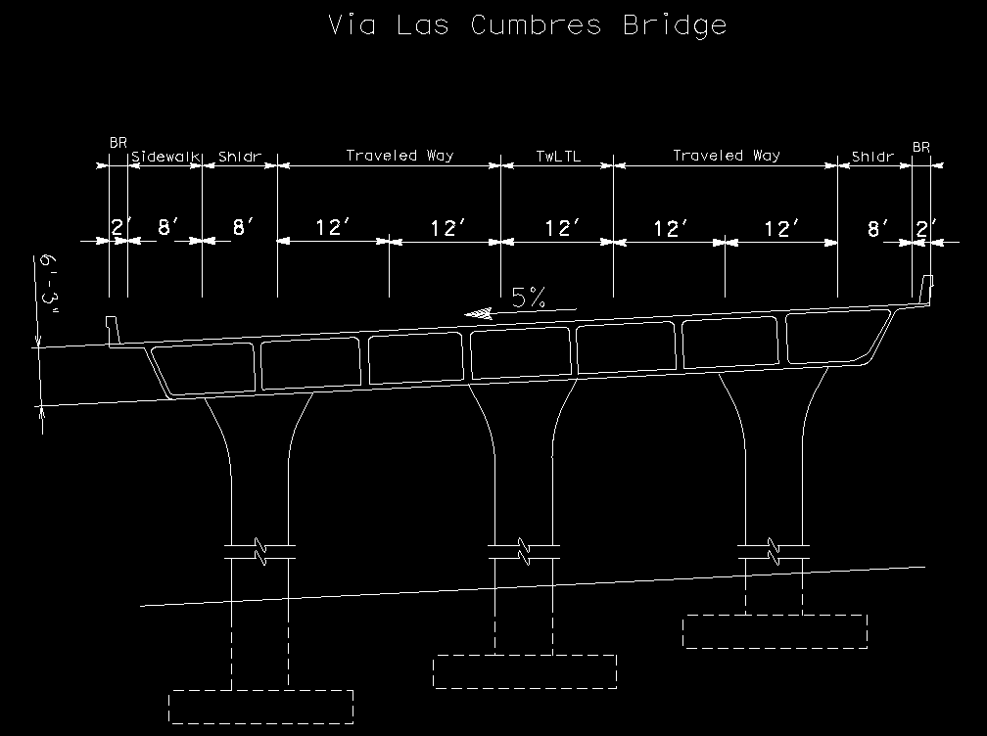
Cross Sections
Viewing road from a different perspective to see the layers and angle of road
Standards, from Highway Design Manual, to follow such as:
Grade of slope
Shoulder width
Lane width
Sidewalk
Railing
Depth of layers & more

Slide 10
Cross Sections
Skills Used:
Trigonometry to figure out lengths
MicroStation

Slide 11
Project Cost Estimate
What is it?
11 Page Estimate
Using Caltrans website, checked previous costs on work items to get a general idea of unit cost
Right Of Way (when projects are outside Caltrans State Row
Support Cost Estimate Summary
Along with that, a quantity sheet showing how work items are quantified on the estimate

Slide 12
Reflection
What did you learn about yourself through working on the internship project?
Challenges & solutions?
Skills utilized & gained?
Overall learning achieved?
What did you learn about the importance of…
Communication?
Self Advocacy?

Slide 13
Questions
My Work As An Intern:
How did you make a meaningful contribution to your workplace (what did you do overall? What were your day to day activities/responsibilities)?
How was your work as an intern meaningful to your education?
How was your work significant or meaningful for you beyond school and your specific internship site?
How did your project(s) go from an idea or inspiration to a final product? (Process from beginning to end)
What did you learn about yourself through working on the internship project(s)? Discuss challenges, solutions, skills utilized & gained, and overall learning achieved.
What did you learn about the importance of (the role of) communication and self advocacy during your internship (with your mentor? Among colleagues?)
My Ideas About Life Outside of High School:
What new appreciations did you develop while working as an intern? Why?
What qualities or characteristics did you see in the people around you that you want to develop in yourself? Why?
How did your view of life beyond high school change or develop during your time as an intern?
How might internship influence the direction of your life (college, career, goals)?
How did communication and/or collaboration at work influence your understanding of professional working environments?

